Slide 1
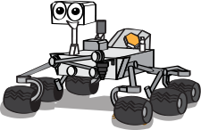
An Open Source Rapid Deployable DIY MARS Rover
Group A2
MARWIN
Team Members
Vyshak P P (VAS15CS113)
Mohamed Sahin V A (VAS15CS068)
Joe S Kolengaden (VAS15CS060)

Slide 2
Contents
Abstract
Problem Statement
Design
Implementation Plan

Slide 3
Introduction
Ever growing demand and developments in space exploration industry have inspired us to create MARWIN.
Rapid industrialization and entry of private firms in space industry have opened up new possibilities for startups.

Slide 4
Abstract: project background
The basic aim behind the project is to address the need of open source projects in space industry.
The MARWIN rover is designed to be modular and customizable according to various explorational needs.
The basic use of MARWIN will be to avail rapid deployable rover solutions in human exploration of other planets.

Slide 5
Problem statement:
The working of space rover cannot be exhibited to the public directly and it is because of high maintenance costs.
There is a lack of open-source projects that support space exploration and related technology.
There is no available prototype or even design for rapid deployable modular rovers.

Slide 6
Design
The design principle of MARWIN is logically divided into 3*3*3 like Rubik’s Cube design approach.
We use Rocker Bogie mechanism for traversing through rough terrain.
We provide any of the scientific equipment in this prototype.
Atmospheric content Sensor : Which enables us to detect the presence of different types of Gases.
Life detecting robotic system : Which detects the presence of biological life form.

Slide 7
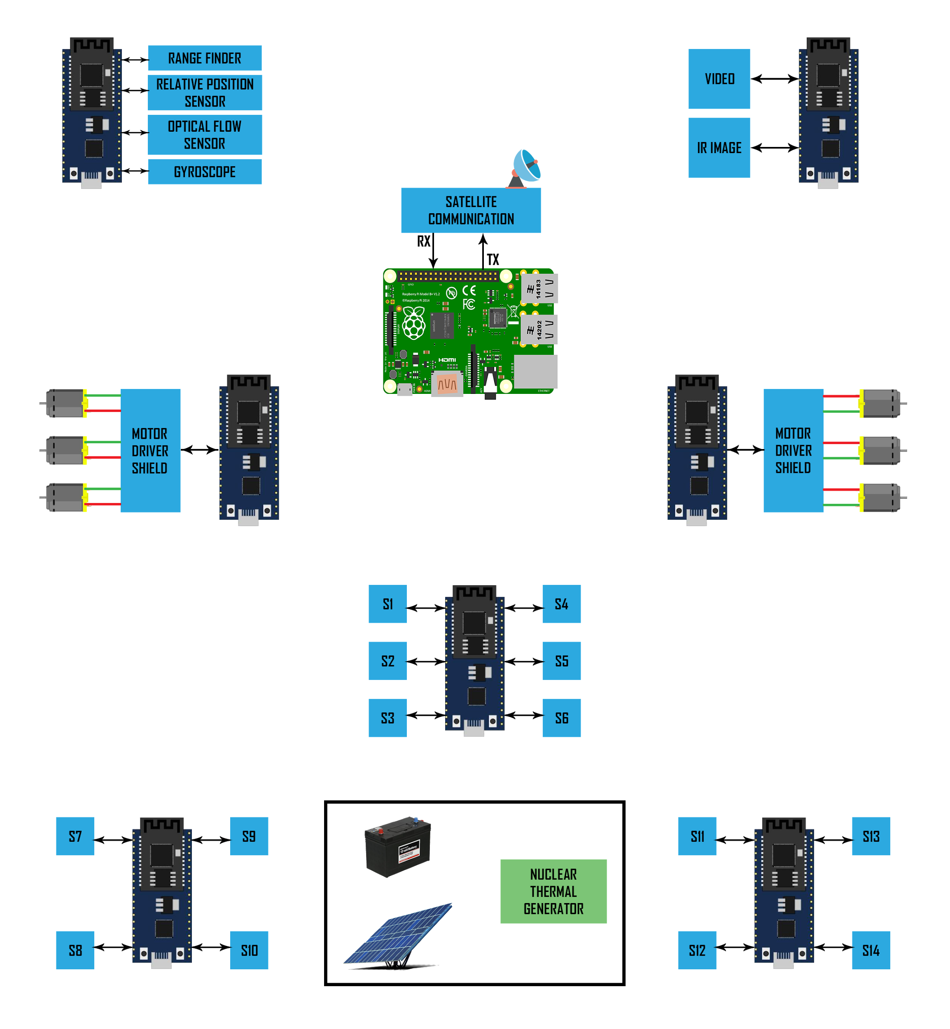
Architecture

Slide 8
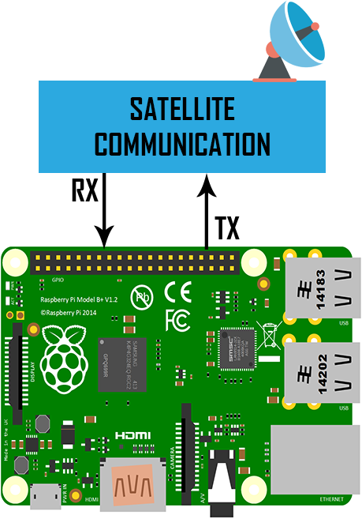
Raspberry Pi 3 B+
It acts as the brain (Motherboard).
Buffers all data in the internal server (Database).

Slide 9
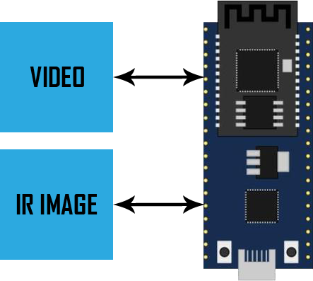
Live Analysis

Slide 10
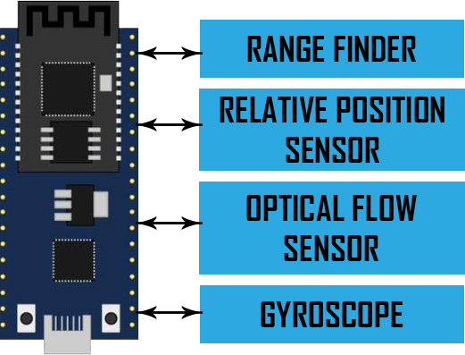
Navigation Block

Slide 11
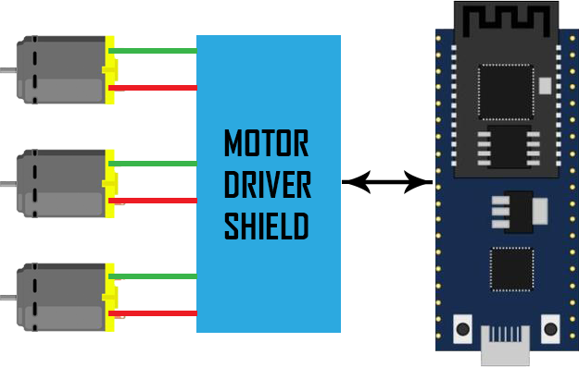
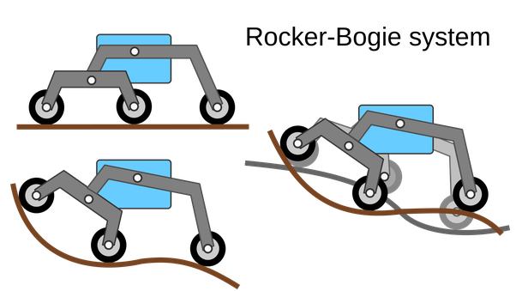
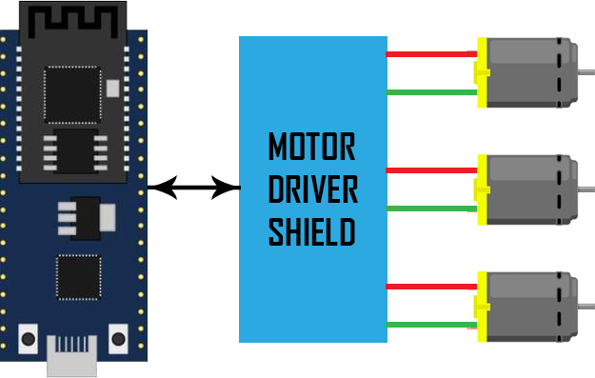
Left Wheel & Right Wheel

Slide 12
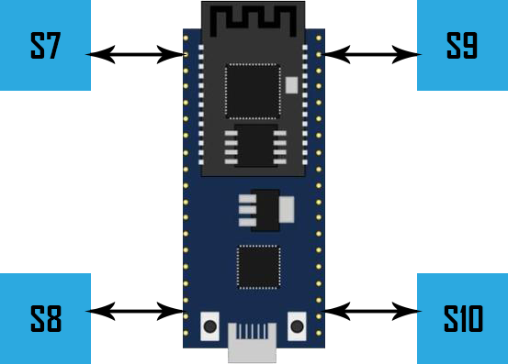
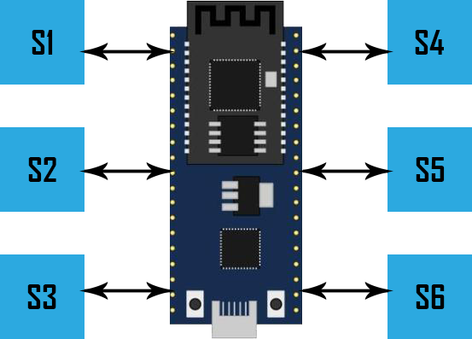
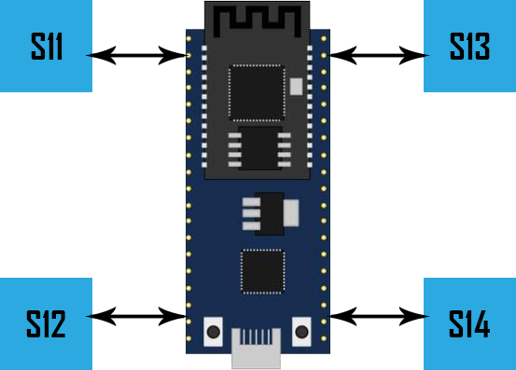
Sensor Cluster 1, 2 & 3

Slide 13
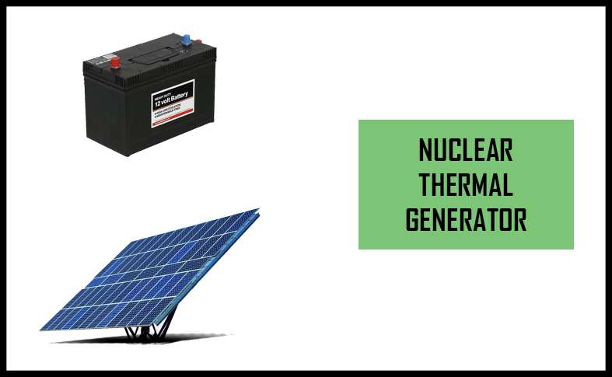
Power management block

Slide 14
Implementation Plan
Rocker-Bogie system with RC .
Scientific equipments ( sensor clusters).
Power management system.
Autonomous navigation.
Video streaming and analysis.
Testing and analysis.
Modification and finalizing the design.
Note: All the project work will be made open source via GitHub.

Slide 15
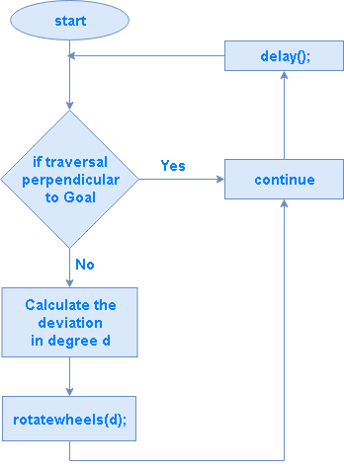
Goal Based Navigation

Slide 16
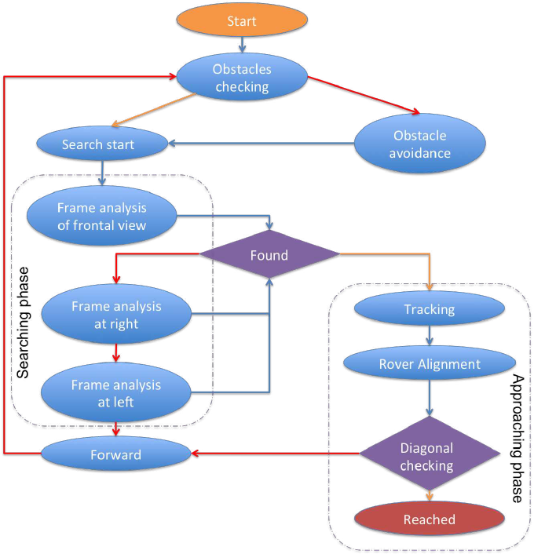
Rover Actions Flowchart

Slide 17
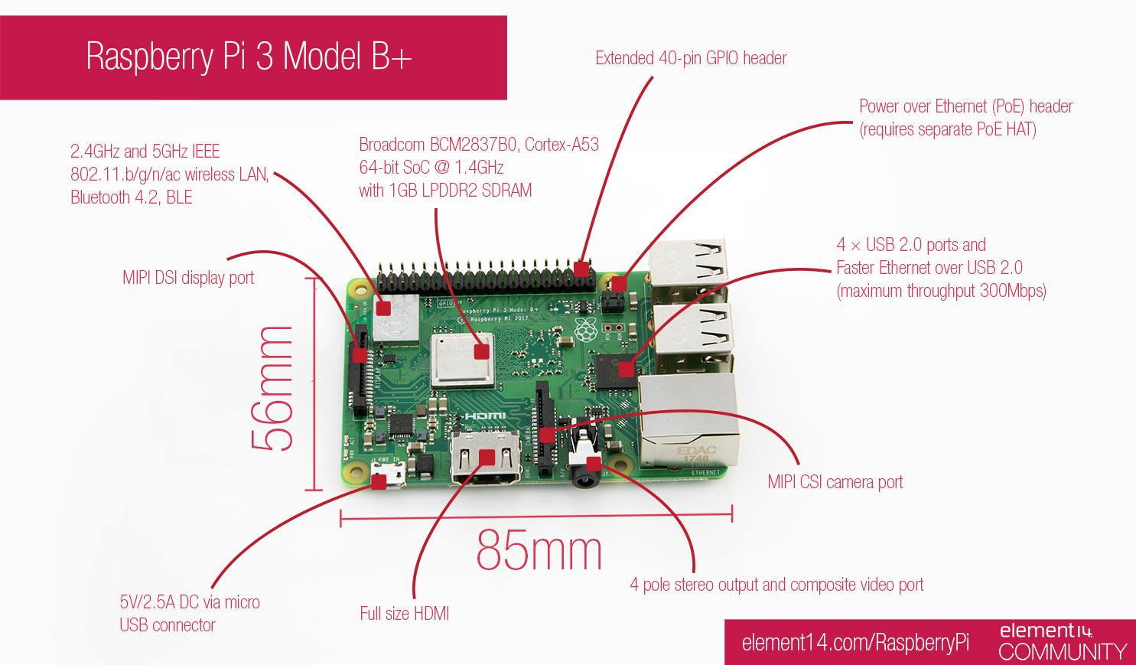

Slide 18
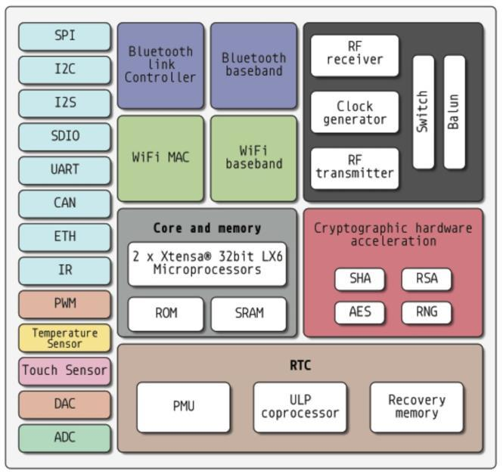
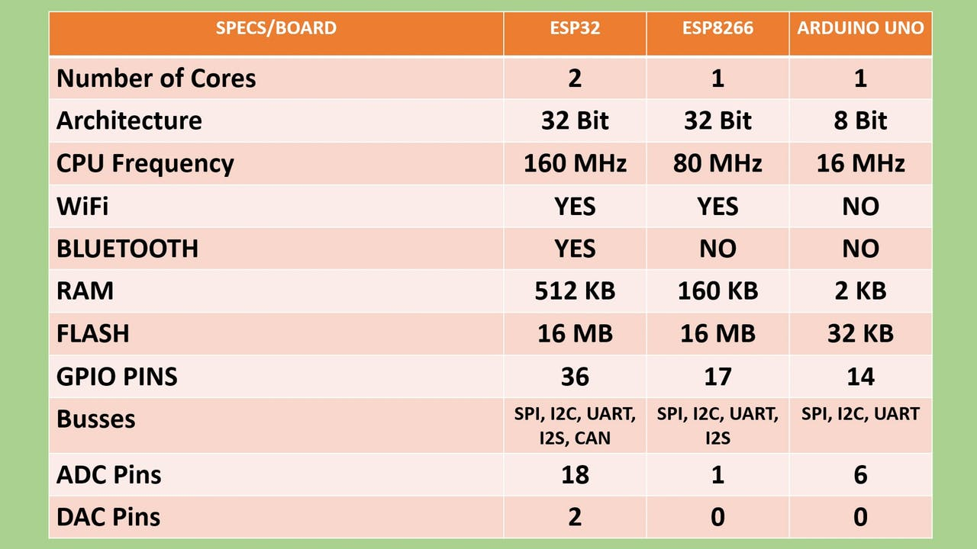
Why ESP32 ?

Slide 19
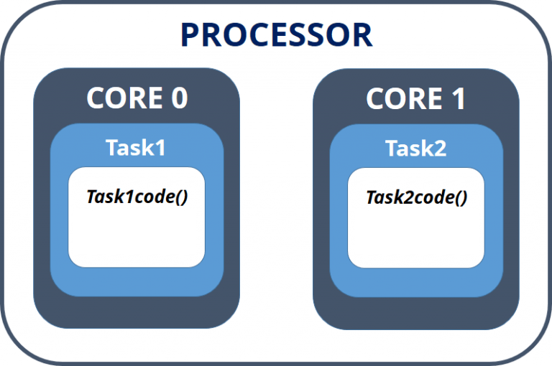
ESP32 dual core
Each core can do different task independently.
Sync can be achieved via Mutually Exclusive Semaphores.
The 32bit dual core clocked at 180Mhz can outperform AtMEga328p( Arduino UNO R3) by

Slide 20
Sensor list
MQ-2 - Methane, Butane, LPG, smoke
MQ-3 - Alcohol, Ethanol, smoke
MQ-4 - Methane, CNG Gas
MQ-5 - Natural gas, LPG
MQ-6 - LPG, butane gas
MQ-7 - Carbon Monoxide
MQ-8 - Hydrogen Gas
MQ-9 - Carbon Monoxide, flammable gasses
MLX90614 - IR temperature sensor
MAG3110 - Magnetometer
ITG 3200 - Gyroscope
ADXL 345 - Accelorometer
TSL 102 - Luminosity sensor
ML8511 - UV detector
BMP180 - Barometric Pressure/altitude sensor
MMA84551 - Inclination sensor

Slide 21
Literature survey
Terrain feature extraction and assessment.
Terrain-Based Navigation
Obstacle-Avoidance Navigation
Goal-Based Navigation
Behavior Integration
Paper: An Intelligent Terrain-Based Navigation System for Planetary Rovers

Slide 22
Literature survey (cont….)
Wheel supporting system.
Wheel defect detection
Wavelet-SVM
Deep Learning
Paper: Wheel defect detection using machine learning.

Slide 23
Literature survey (cont….)
Prototype for searching signs of life in mars.
Laser and reflectometer tech to detect traces of methane.
Surveying and localization of data.
Paper: Robot System to Search for Signs of Life on Mars

Slide 24
Applications…..
Highly modified versions of the rover can be used in fields such as
Defence .
Rescue operations.
Disaster management.
Remote sensing.
Agriculture.
R&D.
And more...

Slide 25
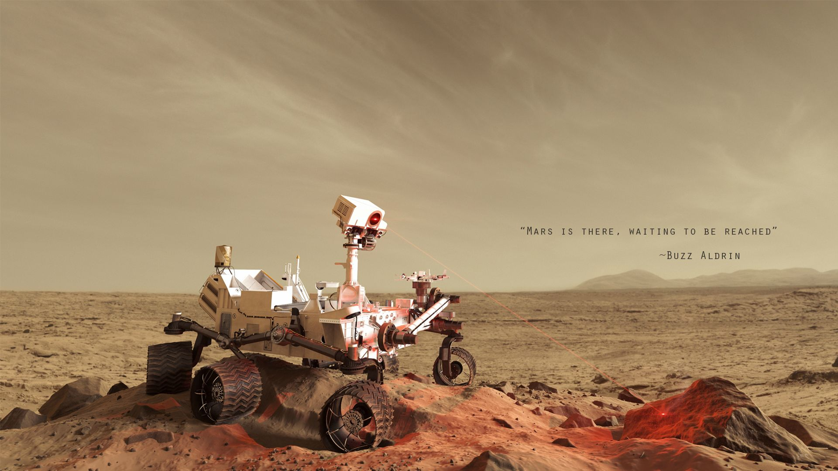
Thank you !!

